Slide 1
BIKE
(Bit-Flipping Key Exchange)
Presented by Ray Perlner

Slide 2
High Level Summary
Variants of McEliece/ Neiderreiter based on Quasi-Cyclic MDPC codes
  Non-algebraic codes like MDPC codes look good for key reduction with quasi cyclic structure
    (unlike algebraic codes e.g. those used in DAGS and BigQuake)
  Performance is competitive with lattice-based schemes, but attack complexity seems easier to analyze.
  Has somewhat high dec. failure rate (< 10⁻⁷); targeting IND-CPA.
Three versions
  BIKE-1: McEliece KEM: Optimized for speed of KeyGen
  BIKE-2: Niederreiter KEM: Optimized for PK, ciphertext size.
  BIKE-3: patented LWE-like “Ouroboros” key exchange.
    Uses modified “noisy syndrome” decoder.
    Slightly different security assumption (probably.)

Slide 3
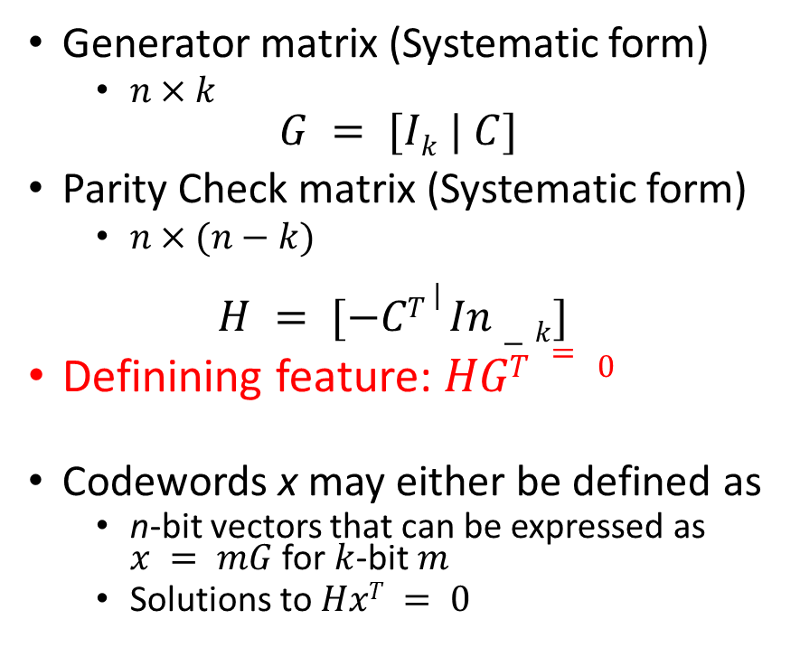
Some Coding Theory
Generator matrix (Systematic form)
  $n×k$
$$G = [Ik | C]$$
Parity Check matrix (Systematic form)
  $n×(n−k)$
$$H = [−CT | In−k]$$
Definining feature: $HGT = 0$
Codewords x may either be defined as
  n-bit vectors that can be expressed as $x = mG$ for $k$-bit $m$
  Solutions to $HxT = 0$
Syndrome: s = H(mG + e)^{T} = H(e^{T})
  Mapping s to minimal weight e is sometimes easy but NP hard in general.
McEliece Encryption: mG + e is ciphertext, m is plaintext.
Niederreiter Encryption: s is ciphertext, e is plaintext.
  Note: Both “McEliece” and Niederreiter KEMs for BIKE use Hash(e) as shared secret.

Slide 4
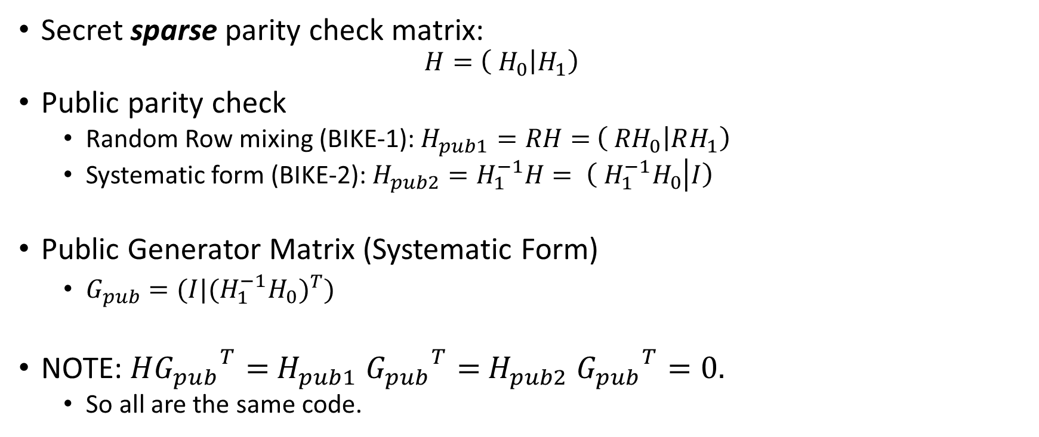
MDPC (Moderate Density Parity Check) Codes
(special case where n = 2k)
Secret sparse parity check matrix:
  $$H=\left( H_{0} | H_{1}\right)$$
Public parity check
  Random Row mixing (BIKE-1): $H_{pub1}=RH=$ $\left( {RH}_{0} | RH_{1}\right)$
  Systematic form (BIKE-2): $H_{pub2}=H_{1}^{−1}H= \left( {H_{1}^{−1}H}_{0} | I\right)$
Public Generator Matrix (Systematic Form)
  $G_{pub}=(I|{{{(H}_{1}^{−1}H}_{0})}^{T})$
NOTE: $H{G_{pub}}^{T}=$ $H_{pub1}$ ${G_{pub}}^{T}=$ $H_{pub2}$ ${G_{pub}}^{T}=0.$
  So all are the same code.

Slide 5

Decoding MDPC codes
(The Bit-Flip Algorithm)
Want to find low weight e such that $He^{T}=s$

Slide 6

Decoding MDPC codes with noisy syndrome
(used in BIKE-3)
Want to find low weight e, e’ such that $He^{T}+ {e′}^{T}=s$

Slide 7
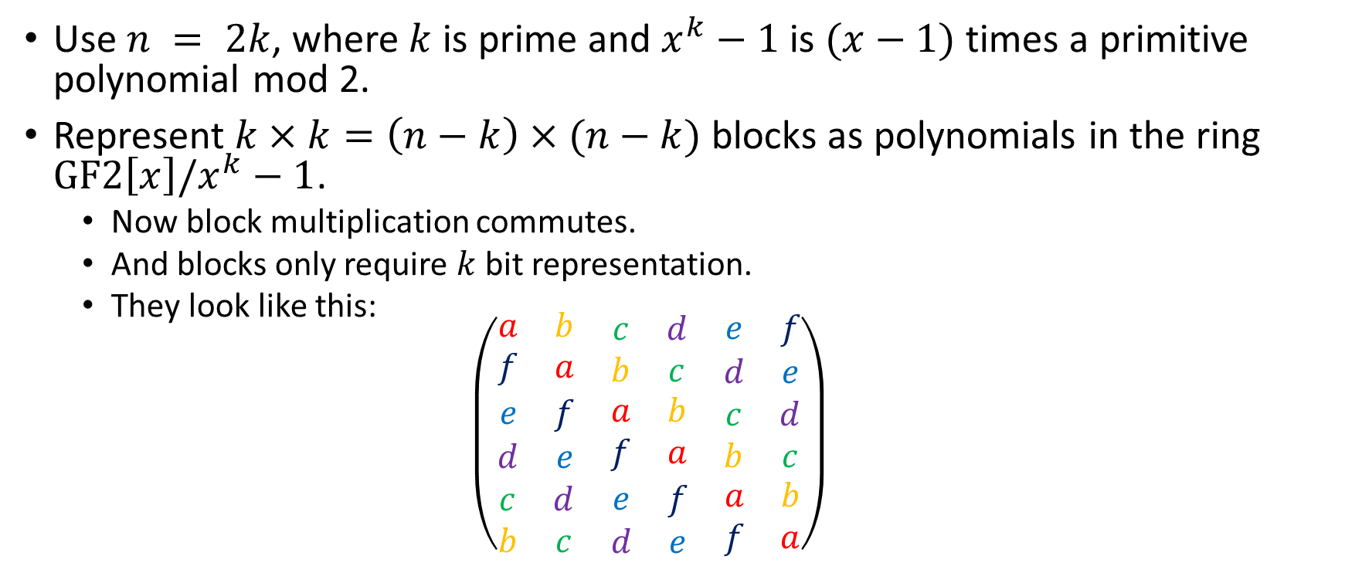
Quasi-Cyclic structure
Use $n = 2k$, where $k$ is prime and $x^{k}−1$ is $(x−1)$times a primitive polynomial mod 2.
Represent $k×k=\left(n−k\right)×(n−k)$ blocks as polynomials in the ring $GF2\left[x\right]/x^{k}−1$.
  Now block multiplication commutes.
  And blocks only require $k$ bit representation.
  They look like this:
  $$\left(\begin{matrix}\begin{matrix}a & b \\ f & a\end{matrix} & \begin{matrix}c & d \\ b & c\end{matrix} & \begin{matrix}e & f \\ d & e\end{matrix} \\ \begin{matrix}e & f \\ d & e\end{matrix} & \begin{matrix}a & b \\ f & a\end{matrix} & \begin{matrix}c & d \\ b & c\end{matrix} \\ \begin{matrix}c & d \\ b & c\end{matrix} & \begin{matrix}e & f \\ d & e\end{matrix} & \begin{matrix}a & b \\ f & a\end{matrix}\end{matrix}\right)$$

Slide 8

BIKE 1-3 Summary Table
(Switching to their notation for variable names.)
$m$ and $g$ are random polynomials in $GF2[x]$/$(x^{r}−1)$
$e0$ and $e1$ are polynomials in the same ring with hamming weights summing to $t$. e, when present has Hamming weight $t/2$.
If you do out the math $s = e0h0+e1h1$(for BIKE-1,2) and $s = e0h0+e1h1 +e$for (BIKE-3)

Slide 9

BIKE Parameters
Polynomials are over ring $GF2[x]$/$(x^{r}−1)$
$n =2r$is the number of bits in the error vector $(e0,e1)$
$t$ is the Hamming weight of the error vector.
$w$ is the row weight of the MDPC code $(h0,h1)$

Slide 10
Performance
(Note: Jacob’s numbers look similar, although consistently larger by a factor of ~2.)
BIKE-1
BIKE-2
BIKE-3

Slide 11
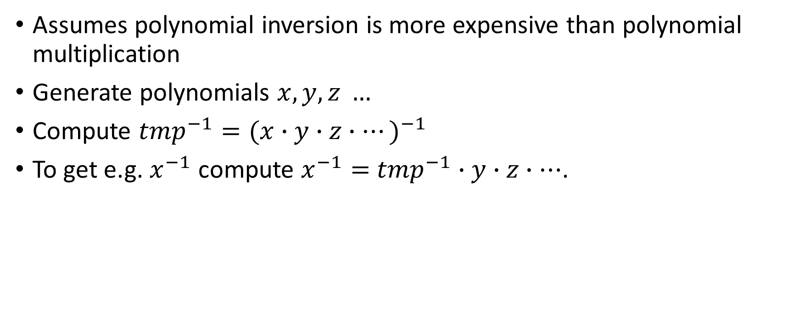
BIKE-2 Batch Key Generation
Assumes polynomial inversion is more expensive than polynomial multiplication
Generate polynomials $x, y, z …$
Compute ${tmp}^{−1}={(x∙y∙z∙…)}^{−1}$
To get e.g. $x^{−1}$ compute $x^{−1}=$ ${tmp}^{−1}$ $∙y∙z∙…$.

Slide 12
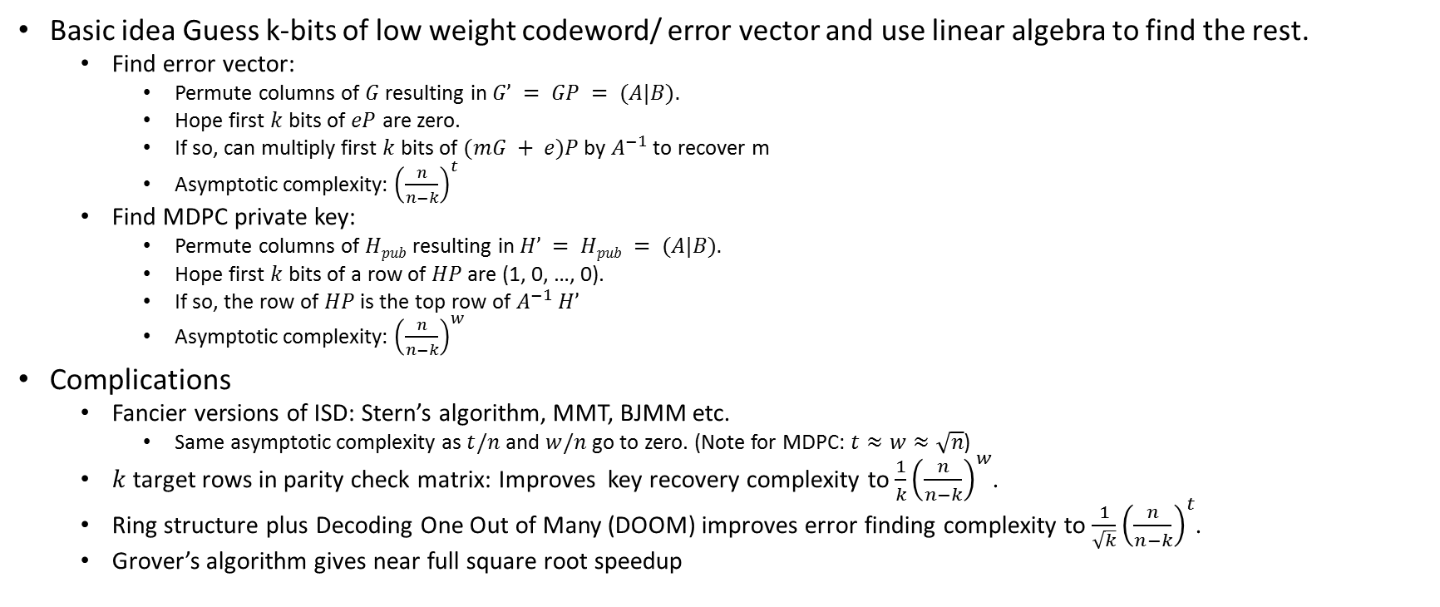
Known attacks: Information Set Decoding
Basic idea Guess k-bits of low weight codeword/ error vector and use linear algebra to find the rest.
  Find error vector:
    Permute columns of $G$ resulting in $G’ = GP = (A|B).$
    Hope first $k$ bits of $eP$ are zero.
    If so, can multiply first $k$ bits of $(mG + e)P$by $A^{−1}$ to recover m
    Asymptotic complexity: ${\left(\frac{n}{n−k}\right)}^{t}$
  Find MDPC private key:
    Permute columns of $Hpub$ resulting in $H’ = Hpub = (A|B).$
    Hope first $k$ bits of a row of $HP$ are (1, 0, …, 0).
    If so, the row of $HP$ is the top row of $A^{−1}$ $H’$
    Asymptotic complexity: ${\left(\frac{n}{n−k}\right)}^{w}$
Complications
  Fancier versions of ISD: Stern’s algorithm, MMT, BJMM etc.
    Same asymptotic complexity as $t/n$ and $w/n$ go to zero. (Note for MDPC: $t≈w≈\sqrt{n}$)
  $k$ target rows in parity check matrix: Improves key recovery complexity to $\frac{1}{k}{\left(\frac{n}{n−k}\right)}^{w}$.
  Ring structure plus Decoding One Out of Many (DOOM) improves error finding complexity to $\frac{1}{\sqrt{k}}{\left(\frac{n}{n−k}\right)}^{t}$.
  Grover’s algorithm gives near full square root speedup

Slide 13
Known attacks: Reaction Attacks
Guo, Johannson, Stankovsky [GJS 2016] show how to recover private key from statistical analysis of decryption failures.
This attack does not affect the claimed security of BIKE, since it is recommended for ephemeral-ephemeral use only, and only claims IND-CPA security.

Slide 14
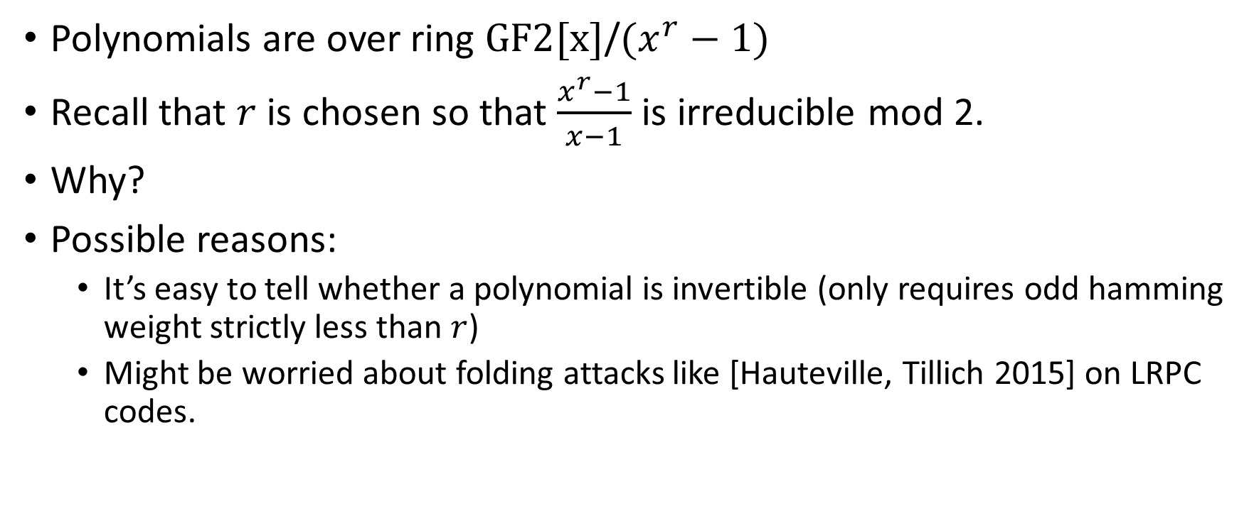
Choice of r
Polynomials are over ring $GF2[x]$/$(x^{r}−1)$
Recall that $r$ is chosen so that $\frac{x^{r}−1}{x−1}$ is irreducible mod 2.
Why?
Possible reasons:
  It’s easy to tell whether a polynomial is invertible (only requires odd hamming weight strictly less than $r$)
  Might be worried about folding attacks like [Hauteville, Tillich 2015] on LRPC codes.

Slide 15
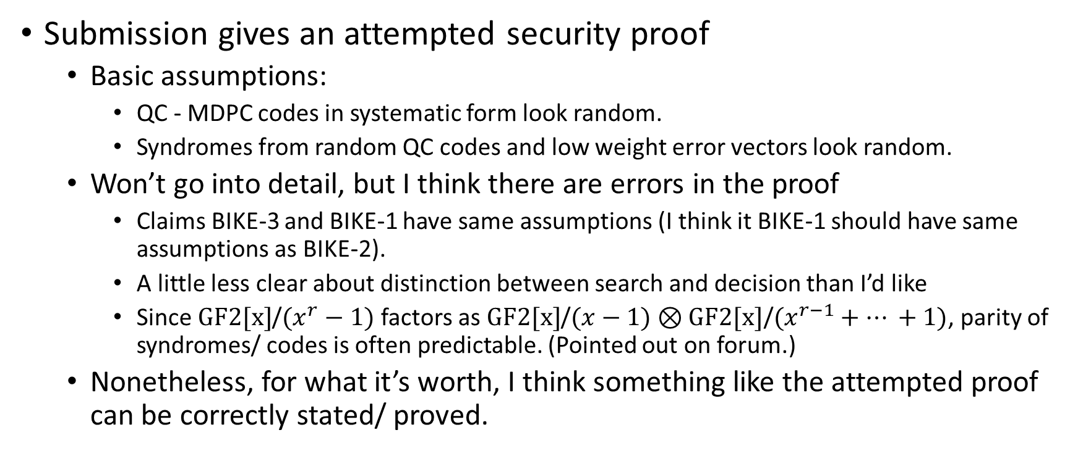
Security Proof
Submission gives an attempted security proof
  Basic assumptions:
    QC - MDPC codes in systematic form look random.
    Syndromes from random QC codes and low weight error vectors look random.
  Won’t go into detail, but I think there are errors in the proof
    Claims BIKE-3 and BIKE-1 have same assumptions (I think it BIKE-1 should have same assumptions as BIKE-2).
    A little less clear about distinction between search and decision than I’d like
    Since $GF2[x]$/$(x^{r}−1)$ factors as $GF2[x]$/$(x−1)⊗GF2[x]\text{/}(x^{r−1}+… +1)$, parity of syndromes/ codes is often predictable. (Pointed out on forum.)
  Nonetheless, for what it’s worth, I think something like the attempted proof can be correctly stated/ proved.

Slide 16
Similar submissions
Straight up knock off
  QC-MDPC-KEM
Pretty much the same problem
  HQC (If BIKE is NTRU, this is RingLWE)
Similar problem; probably harder to analyze
  LEDApkc/LEDAkem
Basically the same scheme, but Rank metric
  LAKE/Locker, Ouroboros-R
Basically the same scheme, but Euclidean metric
  NTRUxxx

Slide 17
Advantages and limitations
Advantages
  All known IND-CPA attacks are well-understood information set decoding type attacks.
    ISD has been known for 45 years and improvements have left asymptotic complexity the same.
    Compares favorably with lattice attacks (stability) and Rank-Metric attacks (newness)
  Relatively small key sizes (10,000 to 65,000 bits)
  Reasonably fast for all operations.
    Except for BIKE2 keygen without batching, operations look like they take less than a millisecond on a good processor for 128 bit security.
Limitations
  High Decryption failure rate
  Does not provide IND-CCA security
  Security proof could use improvement/clarification
  Key/Message sizes are slightly larger than some (ring/ cyclic) lattice and rank schemes.
  Vague possibility there might be something to exploit in ring structure.

